Slide 1
UNIT-IV
ENGINEERING MATERIALS
Composite materials
Liquidcrystals

Slide 2
COMPOSITE MATERIALS Dr.P.Venugopal

Slide 3
Contents:
Definition
Advantages
Uses
Classification
Fibre reinforced composites
Layered composites
Manufacturing methods
Limitations

Slide 4
It may be defined as, the multi phase material consists of two or more physically and or chemically distinct phases and the properties of these materials are different from those of the individual materials of the composite.
The minimum number of constituents are two, they are
i)Matrix(Dispersion medium)-Into which other ingredients will be added ie., it holds all the ingredients.
ii) Reinforced material(Dispersed phase)-These are the substances added to dispersion medium(Matrix)

Slide 5
Advantages of composites:
i) These are more economical than metals and ceramics.
ii) Weight of the composites is less than conventional metallic design.
iii) Due to less weight, these are used in automobile industry to the larger extent for fuel economy(Fuel consumption is less).
iii) Excellent mechanical and chemical properties.
iv) More thermal resistance than conventional materials hence composites provide improved thermal insulation.
v) Corrosion resistance vi) Fabrication is very easy.
s vii) Good aesthetic appeal

Slide 6
Uses:
Transportation industry- Racing vehicle components, engine components, racing boats etc.,
Aerospace rocket components, aircrafts, airbags of cars. Safety equipment like ballistic protection etc.,
Sporting goods ( lawn tennis rockets) and musical instruments
Industrial equipments: High speed machinery, PCB in which composite is an electrically insulating substrate on which electrical circuits are mounted.
Communication antennae

Slide 7
Classification:
Composites are classified into different types based on dispersion medium (matrix) and dispersed phases.
Based on matrix ( dispersion medium) –
composites are classifies into three types. They are
i) Polymer based composites (PCM) :in which polymer is the matrix to which other substances added.
ii) Metal based composites (MCM): in which metal is the matrix to which other substances are added.
iii) Ceramics based composites (CCM): in which Ceramic is the matrix to which other substances are added.
.

Slide 8
Based on reinforcement (dispersed phase) composites are three types: They are,
i) Fibre reinforced composites-Further classified into types they are short and long fibre composites
ii) Particle based composites – Again further classified into large particle based composites and dispersion strengthened composites.
iii) Layered composites- Further classified into unilayer and multilayer composites
Functions of reinforcement materials:
Can provide the required the properties. Orientation, concentration of these materials etc., will decide the properties.

Slide 9
Functions of matrix:
i) It binds the dispersed phase
ii) It acts as medium by which an externally applied load is transmitted and distributed to the dispersed phase
iii) It keeps the reinforced fibres in the proper position and orientation so that they can carry the load uniformly.
iv) It protects the individual fibres from chemical reaction with environment.

Slide 10
Fibre based composites- Fibre is a long thread like filament in which fibre is the rein forcing material.
Further classified into three types based on the nature of fibre, they are
1) Glass fibre based composites
2) Carbon fibre based composites
3) Aramid fibre based composite

Slide 11
I) Glass fibre reinforced composites:s
These are prepared by allowing the glass melt through a small and pulling and cooling rapidly which gives a film. The film is glass fibre.
Properties: i) These are lighter in weight but slightly higher than aramid fibre composites.
ii) High tensile strength
iii) High impact resistances.
iv) High chemical inertness
v) Lower densities vi) Corrosion resistance vii) In expensive( Low cost),
Limitations:
i) Limited working temperature ii) Do not possess the desired stiffness and rigidity at elevated temperatures.
Applications: i) Automobile parts ii) Lining materials for storage tanks iii) Plastic pipes iv) Transportation industry to reduce fuel consumption.

Slide 12
ii) Carbon based fibre rein forced composites:
These are prepared by carbonisation of high carbon content material at 1000ºC, which gives thread like film known as carbon fibre.
Properties: i) Heavy weight ii) High tensile strength iii) Highly expensive iv) The diameter of C fibre is in the range of 5-10 microns. V) High specific strength. Vi) Good resistance to moisture, acids, bases and various solvents. Vii) High performance c-fibres are used as dispersed phase in polymer matrix which posses excellent stability to higher temperature, corrosion resistance etc., viii) Lighter in weight.
Limitations: i) Highly expensive, due to the difficulties causes in manufacturing.
Applications: i) Body and stabiliser components of helicopters
ii) Military and commercial aircraft structural components such as wings.
Iii) Due to extreme tensile strength, used as sports and recreational equipments like fishing rods, golf clubs, hockey sticks etc.,

Slide 13
III) Aramid based fibre rein forced composites:
These are prepared by dissolving aramid polymer in anhydrous H₂SO₄ and the resultant solution is subjected to spinning until a solid thin film is formed. Generally Kevlar is used as aramid fibre.
Properties:i)Ultra Light in weight ii) High tensile strength iii) Moderate expensive iv) Excellent toughness v) Resistance to creep and fatigue failure vi) Stable to higher
temperature vii) Non conducting nature viii) Retain mechanical properties for a wide temperature range (-200 to 200ºC) viii) Much better mechanical properties than steel and metals.
Limitations: i) They are attacked by strong acids and bases ii) Highly sensitive to UV light
Applications: i) Used in automobile brakes, clutches, Ship hulls, Commercial aircrafts like Boeing 767 and Airbus 320 .

Slide 14
Layered composites:
Based on number of layers, these are two types they are uni layer and multi layer composites.
Based on structural, these are two types they are laminated and sandwiched composites.
Laminar or laminated composites:
Number of composites are stacked together using adhesive material.
- As no of layers increases stiffness also increased.
-Stiffness also depends on the direction of layers.
-When the load is applied on the first layer, it is dissipated uniformly through adhesive.

Slide 15
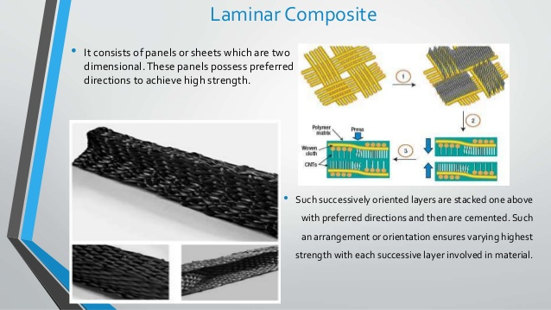
Laminar:

Slide 16
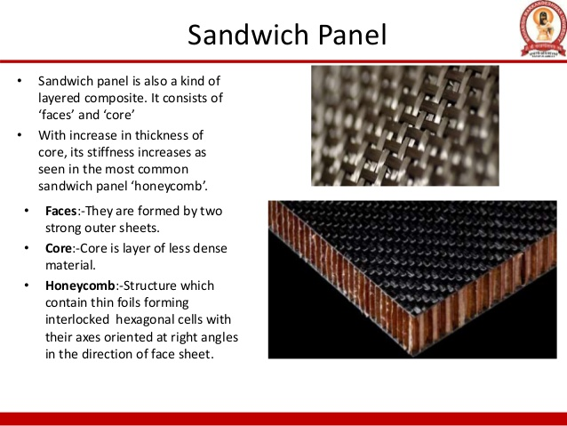
Sandwich composites

Slide 17
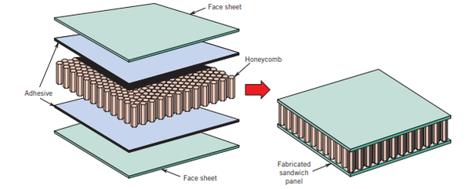
Fig:

Slide 18
Applications:
Laminar composites are used
-as roofing sheets,
readymade walls and
- lining for storage tanks etc.,
Sandwiched composites are used
as wings of aero plains, helicopters etc.,
-Ship hulls

Slide 19
Manufacturing methods:
Composites can be prepared by two methods; they are open and closed moulding methods.
Hand Lay-up technique is one of the open moulding methods.
The processing steps are quite simple.
The required materials are
1) Matrix 2) Resin 3) Release gel 4) Hardner
5) Reinforcing material
Matrix like Epoxy, polyester, polyvinyl ester, phenolic resin, unsaturated polyester, polyurethane resin are used.
Reinforcement like Glass fibre, carbon fibre, aramid fibre, natural plant fibres (sisal, banana, nettle, hemp, flax etc.) are used.

Slide 20
Steps involved in the process:
i)Release gel is sprayed on the mould surface to avoid the sticking of polymer to the surface. Thin plastic sheets are used at the top and bottom of the mould plate to get good surface finish of the product.
ii) Reinforcement in the form of woven mats or chopped strand mats is cut as per the mould size and placed at the surface of mould after perspex sheet.

Slide 21
iii) Then thermosetting polymer in liquid form is mixed thoroughly in suitable proportion with a prescribed hardner (curing agent) and poured onto the surface of mat already placed in the mould. The polymer is uniformly spread with the help of brush.
iv) After curing either at room temperature or at some specific temperature, then mould is opened and the developed composite part is taken out and further processed. The time of curing depends on type of polymer used for composite processing

Slide 22
Advantages: i)Production rate is less, simple and inexpensive
ii)Capital and infrastructural requirement is less. Iii) Normal temperature and less time is required for curing than other methods.
Limitations: Can be used to make smaller structures only Complex structures can’t be moulded.
Mass production can’t be taken places
Applications: Areas like aircraft components, automotive parts, boat hulls, dais board, deck etc.

Slide 23
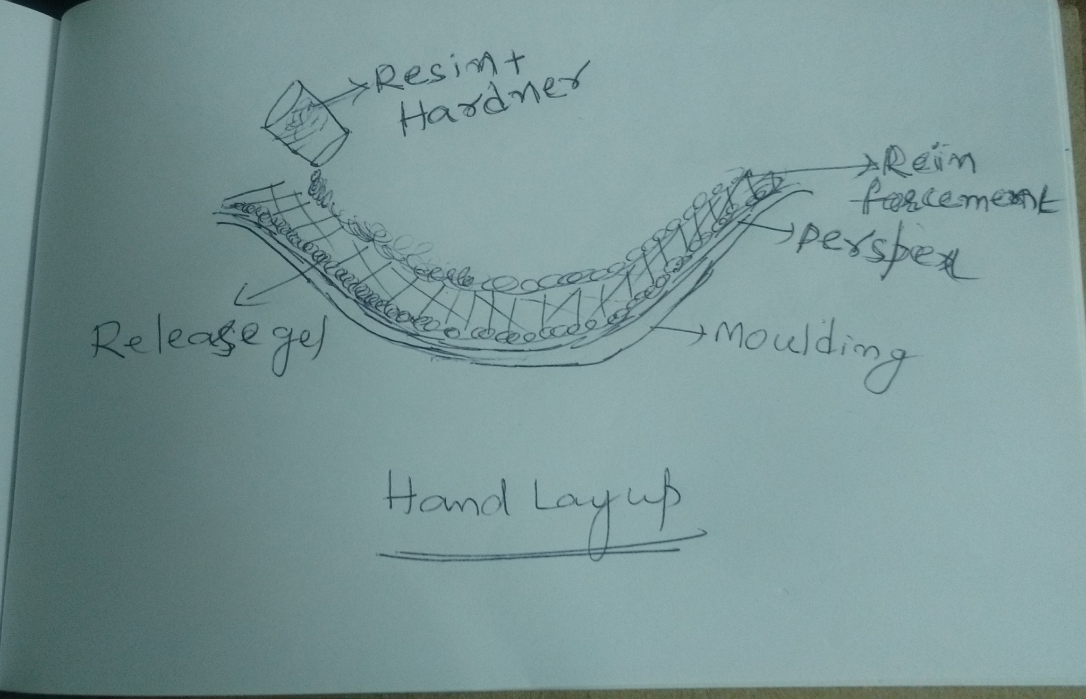

Slide 24
RESIN TRANSFER METHOD(RTM)
It is one of the closed moulding methods.
Five steps are involved in the process:
Creating preform: Reinforced material is made into required shape. Generally glass fibre is used as reinforced material.
Preform layup : The preformed shape should be placed in moulding cavity that has the shape of the desired product.
Moulding: Before placing perform the moulding cavity is coated with release gel which does not allow sticking to the moulding cavity. The moulding cavity is provided with inlet and out let. Preform is placed in cavity and closed with clamps. The entrapped air is sent out through outlet using evacuated pump.

Slide 25
Catalyze phase: Allow the low viscosity resin slowly along with additives till the cavity filled. Under the influence of additives the resin will undergo polymerisation and forms composite material.
Curing phase: During this time resin undergoes polymerisation and forms a solid composite material. Depending on the resin 24 to 48 hours required for solidification.

Slide 26
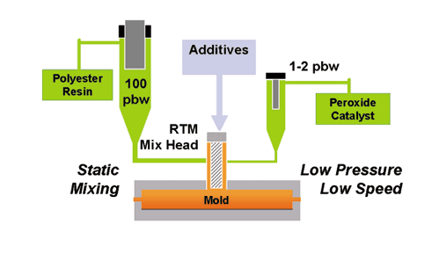
Schematic diagram:

Slide 27
Precautions: The size of the moulding cavity should be equal to thickness of the final product.
Advantages: i) Labour cost is minimum ii) Good surface area iii) Large and complex shapes can be moulded iv) Low capital investment v) Wide range of resins can be used.
Limitations: i) Large thickness composites cant be made.
ii) Glass fibre reinforced material cant be stable at extreme high temperatures.

Slide 28
Pultrusion method
-It is one of the closed molding methods.
Two types of pultrusion process
i) Ordinary pultrusion process can be provided a straight chain composites materials
ii) Radius pultrusion technique can provide 2D and 3D curved composites.
Advantage: Continuous constant cross section shapes of any length can be manufactured with low cost

Slide 29
The following steps are involved in the process,
i) As per the thickness of desired product, the reinforced material allow in the form of fibre through rollers. Generally carbon fibre and glass fibre reinforcement are used
ii) The reinforced material is allowed to pass through resin impregnator where fibre can be soaked in resin. Generally polyethylene
ter pththalate and tri butyl phthalate etc. are used as resin.
.

Slide 30
iii) The fibre is coated with resin and allows passing through heat source where resin undergoes polymerisation and solidification
iv) The solid composite pulled through pulling mechanism which provides uniform thickness of composites.
v) The uniform thickness of composite is subjected to final product as the desired shape and size.

Slide 31
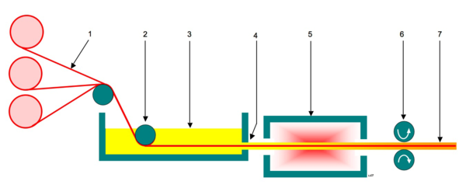
The schematic diagram is
1 – Continuous roll of reinforced fibres/woven fibre mat 2 – Tension roller 3 – Resin Impregnator 4 – Resin soaked fibre 5 – Die and heat source 6 – Pull mechanism 7 – Finished hardened fibre reinforced polymer

Slide 32
Applications: -Used in agriculture and chemical industries.
In construction industry for the, PVC windows etc.,
Used in aero –space industry as various components of aircraft.
Used in automobile industry for the production of complex parts of the vehicles with enhance stiffness, rigidity and light weight, production of car cases etc.,

Slide 33
Filament winding process
-Used to manufacture hollow, circular such as pipes, storage tanks, aerospace parts, etc.,
Materials: Fiber- C, Glass, Aramid or metal fiber
Resin- Phenolic resins, polyurethanes, polyesters etc.,
-It is the process of winding fiber material and resin( resin impregnated fiber) around a shape known as mandrel to create a composite material.
-Automated winding equipment is used for winding on mandrel
-

Slide 34
Process:
-Precision high speed positioning of continuous fiber in a predetermined pattern is the basis for this process. Winding pattern like winding angle has effect on mechanical properties of resultant composite material.
-There is a mandrel that the resin coated fiber wound upon and after the desired number of layers applied curring process is carried out either in room temperature or auto clave or oven.
-After curing, mandrel is removed leaving a hollow composite structure.

Slide 35
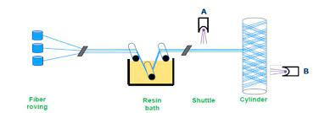
Advantages: Process is automation results cost saving
-Continuous fibers leads to very good properties like strength, stiffness etc.,
-High fiber volume
Disadvantages: Mandrel could be complex and expensive
-Unable to change fiber path within one layer

Slide 36
THANK YOU

